Slide 1
Virtual Memory
A technique that allows the execution of processes that are not completely in memory.
Advantages
Programs can be larger than physical memory.
It abstracts main memory into an extremely large, uniform array of storage, separating logical memory as viewed by the user from physical memory.
This technique frees programmers from the concerns of memory-storage limitations.
Virtual memory also allows processes to share files easily and to implement shared memory.
In addition, it provides an efficient mechanism for process creation.

Slide 2
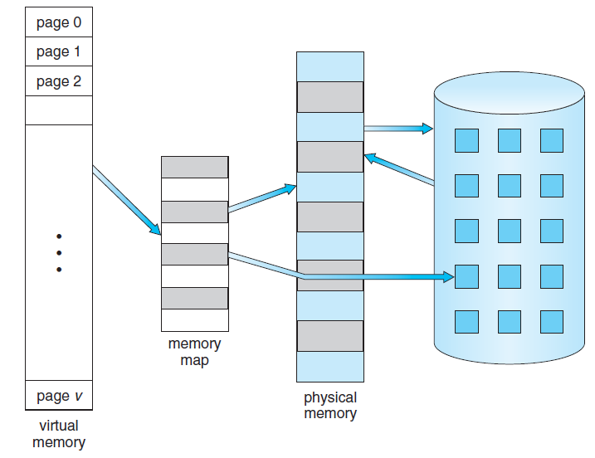
Virtual Memory

Slide 3
Demand Paging
With demand-paged virtual memory, pages are loaded only when they are demanded during program execution.
Pages that are never accessed are thus never loaded into physical memory

Slide 4
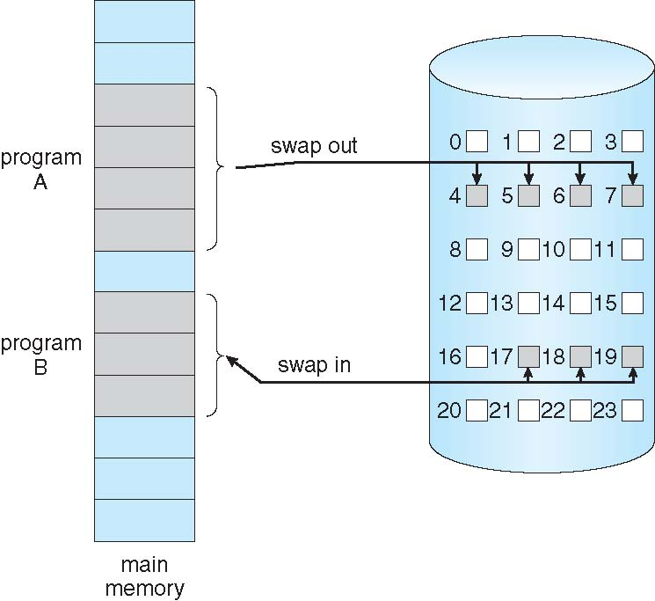
Demand Paging
Could bring entire process into memory at load time
Or bring a page into memory only when it is needed
Less I/O needed, no unnecessary I/O
Less memory needed
Faster response
More users
Similar to paging system with swapping
Page is needed ⇒ reference to it
invalid reference ⇒ abort
not-in-memory ⇒ bring to memory
Lazy swapper – never swaps a page into memory unless page will be needed
Swapper that deals with pages is a called pager
Notes:
93

Slide 5
Demand Paging
If pages needed are already memory resident
No difference from non demand-paging
If page needed and not memory resident
Need to detect and load the page into memory from storage
Without changing program behavior
Without programmer needing to change code

Slide 6
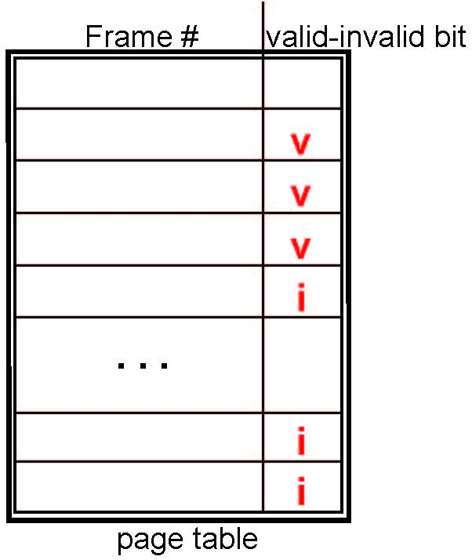
Valid-Invalid Bit
With each page table entry a valid–invalid bit is associated (v ⇒ in-memory – memory resident, i ⇒ not-in-memory)
Initially valid–invalid bit is set to i on all entries
Example of a page table snapshot:
During MMU address translation, if valid–invalid bit in page table entry is i ⇒ page fault
Notes:
93

Slide 7
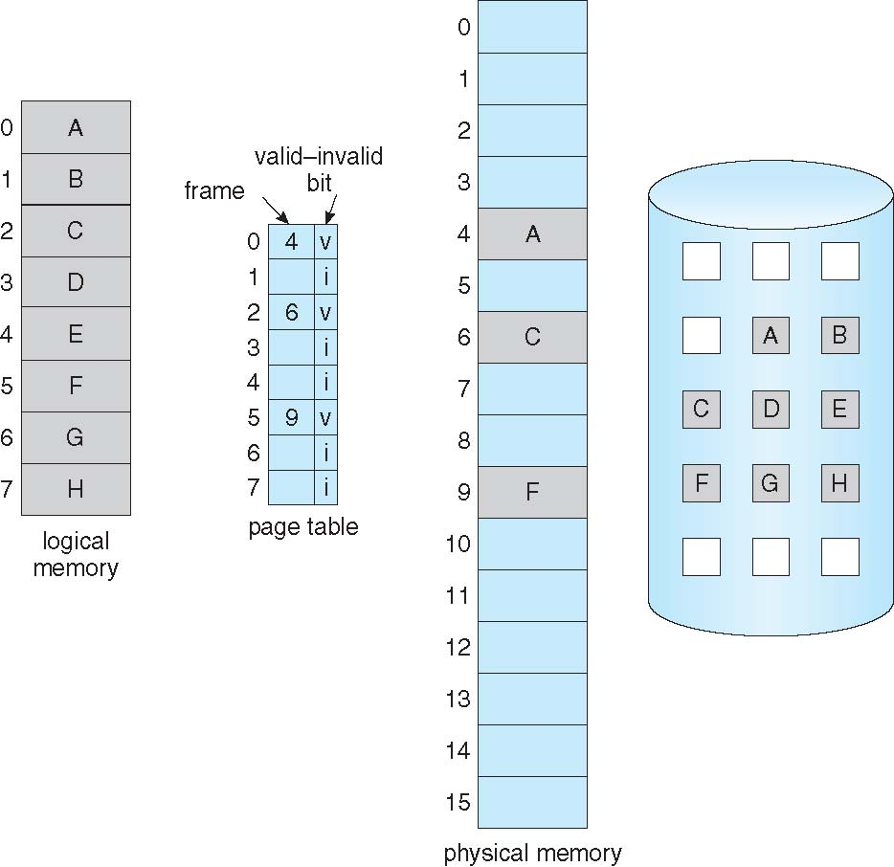
Page Table When Some Pages Are Not in Main Memory
Notes:
93

Slide 8
Page Fault
The paging hardware, in translating the address through the page table, will notice that the invalid bit is set, causing a trap to the operating system.
This trap is the result of the operating system’s failure to bring the desired page into memory.
After this page is brought into memory, the process continues to execute, faulting as necessary until every page that it needs is in memory.
At that point, it can execute with no more faults.
This scheme is pure demand paging: never bring a page into memory until it is required.

Slide 9
Procedure for Handling Page Fault
Check an internal table (usually kept with the PCB) for this process to determine whether the reference was a valid or an invalid memory access.
If the reference was invalid, terminate the process.
If it was valid but that page was not brought in, now bring the page in.
Find a free frame (by taking from free-frame list).

Slide 10
Procedure for Handling Page Fault …
Schedule a disk operation to read the desired page into the newly allocated frame.
When the disk read is complete, modify the internal table kept with the process and the page table to indicate that the page is now in memory.
Restart the instruction that was interrupted by the trap.
The process can now access the page as though it had always been in memory.

Slide 11
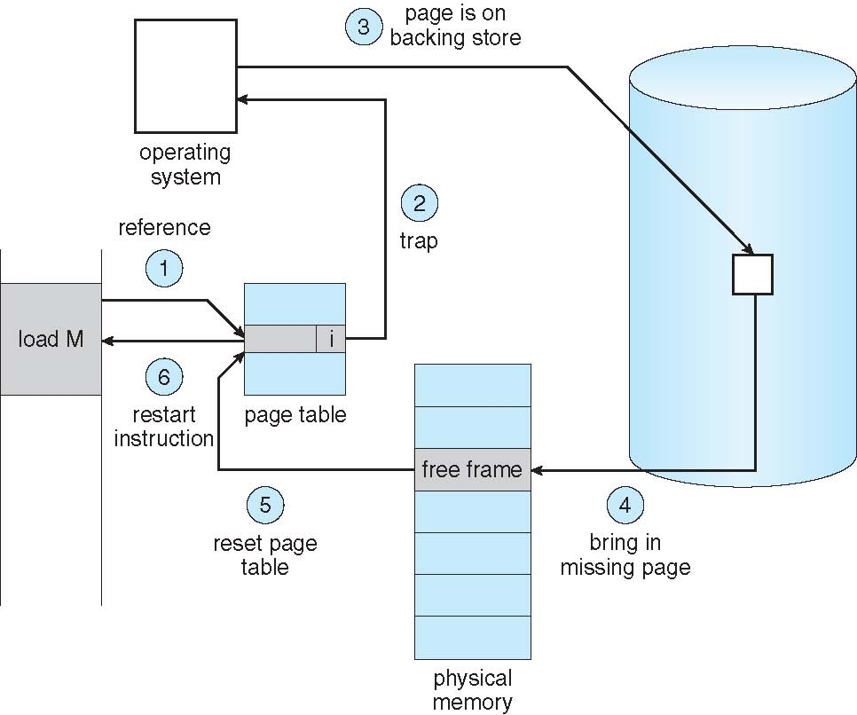
Handling a Page Fault
Notes:
93

Slide 12
Instruction Restart
Consider an instruction that could access several different locations
block move
In one solution, the microcode computes and attempts to access both ends of both blocks.
The other solution uses temporary registers to hold the values of overwritten locations.
If there is a page fault, all the old values are written back into memory before the trap occurs.
This action restores memory to its state before the instruction was started, so that the instruction can be repeated.

Slide 13
Performance of Demand Paging
Stages in Demand Paging
Trap to the operating system
Save the user registers and process state
Determine that the interrupt was a page fault
Check that the page reference was legal and determine the location of the page on the disk
Issue a read from the disk to a free frame:
Wait in a queue for this device until the read request is serviced
Wait for the device seek and/or latency time
Begin the transfer of the page to a free frame
While waiting, allocate the CPU to some other user
Receive an interrupt from the disk I/O subsystem (I/O completed)
Save the registers and process state for the other user
Determine that the interrupt was from the disk
Correct the page table and other tables to show page is now in memory
Wait for the CPU to be allocated to this process again
Restore the user registers, process state, and new page table, and then resume the interrupted instruction
Notes:
93

Slide 14
Performance of Demand Paging (Cont.)
Three major activities
Service the interrupt – careful coding means just several hundred instructions needed
Read the page – lots of time
Restart the process – again just a small amount of time
Page Fault Rate 0 ≤ p ≤ 1
if p = 0 no page faults
if p = 1, every reference is a fault
Effective Access Time (EAT)
EAT = (1 – p) x memory access
+ p (page fault overhead
+ swap page out
+ swap page in )
Notes:
93

Slide 15
Demand Paging Example
Suppose Memory access time = 200 nanoseconds
Suppose Average page-fault service time = 8 milliseconds
EAT = (1 – p) x 200 + p (8 milliseconds)
= (1 – p x 200 + p x 8,000,000
= 200 + p x 7,999,800
If one access out of 1,000 causes a page fault, then
EAT = 8.2 microseconds.
This is a slowdown by a factor of 41!!
If want performance degradation < 10 percent
220 > 200 + 7,999,800 x p
20 > 7,999,800 x p
p < .0000025
< one page fault in every 400,000 memory accesses
Notes:
93

Slide 16
Demand Paging Optimizations
Swap space I/O is faster than file system I/O even if on the same device
Swap allocated in larger chunks, less management needed than file system
Copy entire process image to swap space at process load time
Then page in and out of swap space
Used in older BSD Unix
Copy as required from file system but write to swap space for subsequent paging

Slide 17
Demand Paging Optimizations
Demand page in from program binary on disk, but discard rather than paging out when freeing frame
Used in Solaris and current BSD
Still need to write to swap space the pages not associated with a file (like stack and heap) – anonymous memory
Pages modified in memory but not yet written back to the file system
Mobile systems
Typically don’t support swapping
Instead, demand page from file system and reclaim read-only pages (such as code)

Slide 18
Copy-on-Write
Allows both parent and child processes to initially share the same pages in memory
If either process modifies a shared page, only then is the page copied
More efficient process creation as only modified pages are copied
All unmodified pages can be shared by the parent and child processes.
Only pages that can be modified need be marked as copy-on-write.
Pages that cannot be modified (pages containing executable code) can be shared by parent and child.
Notes:
93

Slide 19
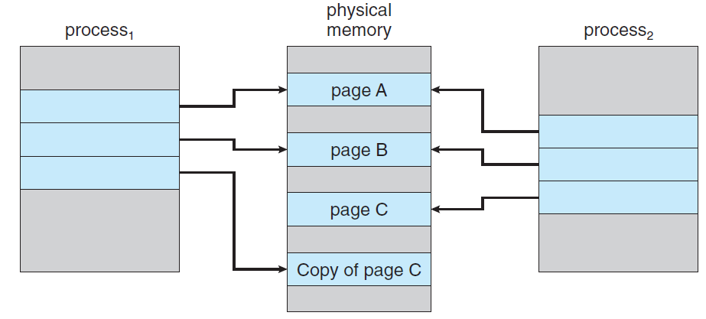
Copy-on-Write: After a process modified page C

Slide 20
Copy-on-Write
In general, free pages are allocated from a pool of zero-fill-on-demand pages
Pool should always have free frames for fast demand page execution
Don’t want to have to free a frame as well as other processing on page fault
Why zero-out a page before allocating it?
vfork() variation on fork() system call has parent suspend and child using copy-on-write address space of parent
Designed to have child call exec()
Very efficient

Slide 21
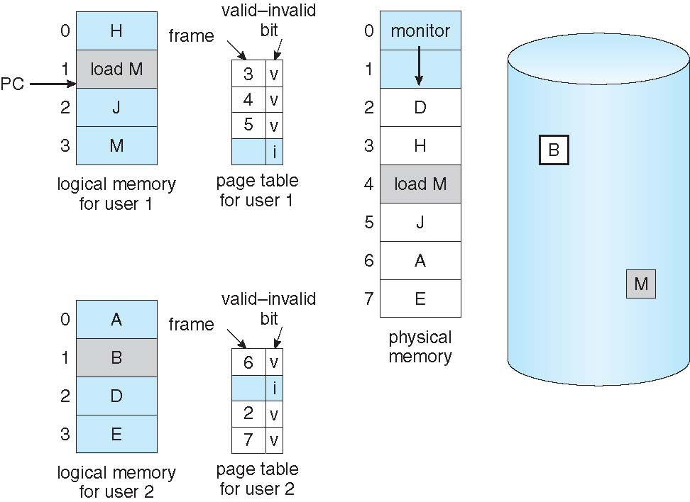
Need For Page Replacement
Notes:
93

Slide 22
Page Replacement
Prevent over-allocation of memory by modifying page-fault service routine to include page replacement
Use modify (dirty) bit to reduce overhead of page transfers – only modified pages are written to disk
Page replacement completes separation between logical memory and physical memory – large virtual memory can be provided on a smaller physical memory
Notes:
93

Slide 23
Basic Page Replacement
Find the location of the desired page on disk
Find a free frame:
If there is a free frame, use it
If there is no free frame, use a page replacement algorithm to select a victim frame
Write victim frame to disk if dirty
Bring the desired page into the (newly) free frame; update the page and frame tables
Continue the process by restarting the instruction that caused the trap
Notes:
93

Slide 24
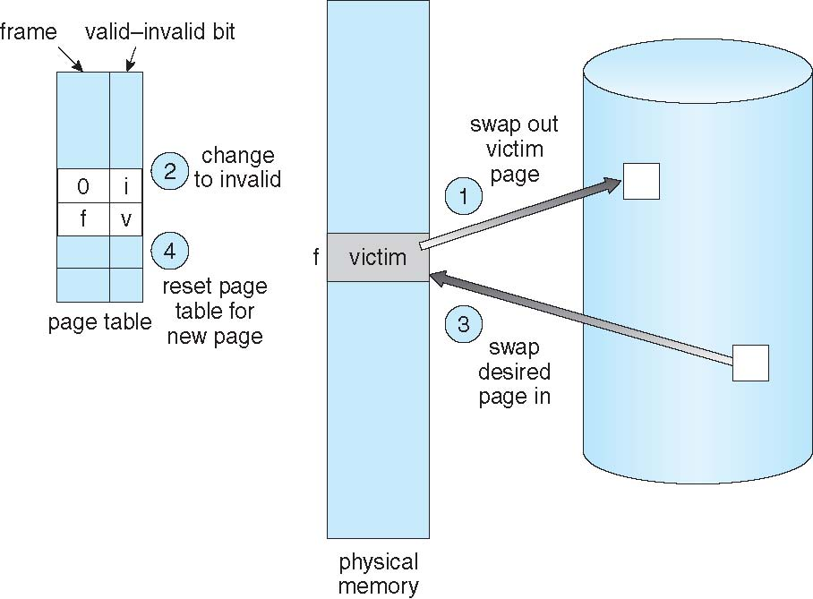
Page Replacement
Notes:
93

Slide 25
Page Replacement
Potentially two page transfers for page fault – increasing EAT
Concept of Modify Bit / Dirty Bit
Each page or frame has a modify bit associated with it in the hardware.
The modify bit for a page is set by the hardware whenever any byte in the page is written into, indicating that the page has been modified.
When a page is selected for replacement, its modify bit is examined.
If the bit is set, the page has been modified since it was read in from the disk.
In this case, the page must be written to the disk.
If the modify bit is not set, however, the page has not been modified since it was read into memory (discarded)

Slide 26
Frame Allocation
Consider a simple case of a system with 128 frames.
The operating system may take 35, leaving 93 frames for the user process.
Under pure demand paging, all 93 frames would initially be put on the free-frame list.
When a user process started execution, it would generate a sequence of page faults.
The first 93 page faults would all get free frames from the free-frame list.
When the free-frame list was exhausted, a page-replacement algorithm would be used to select one of the 93 in-memory pages to be replaced with the 94th, and so on.
When the process terminated, the 93 frames would once again be placed on the free-frame list.
There are many variations on this simple strategy.
We can require that the operating system allocate all its buffer and table space from the free-frame list.
When this space is not in use by the operating system, it can be used to support user paging.

Slide 27
Page and Frame Replacement Algorithms
Frame-allocation algorithm determines
How many frames to give each process
Which frames to replace
Page-replacement algorithm
Want lowest page-fault rate on both first access and re-access
Evaluate algorithm by running it on a particular string of memory references (reference string) and computing the number of page faults on that string
String is just page numbers, not full addresses
Repeated access to the same page does not cause a page fault
To determine the number of page faults for a particular reference string and page-replacement algorithm, we also need to know the number of page frames available.
Obviously, as the number of frames available increases, the number of page faults decreases.
Notes:
93

Slide 28
Reference String
We can generate reference strings artificially (by using a random-number generator, or we can trace a given system and record the address of each memory reference.
For a given page size (page size is generally fixed by the hardware or system), we need to consider only the page number, rather than the entire address.
If we have a reference to a page p, then any references to page p that immediately follow will never cause a page fault.
Page p will be in memory after the first reference, so the immediately following references will not fault.

Slide 29
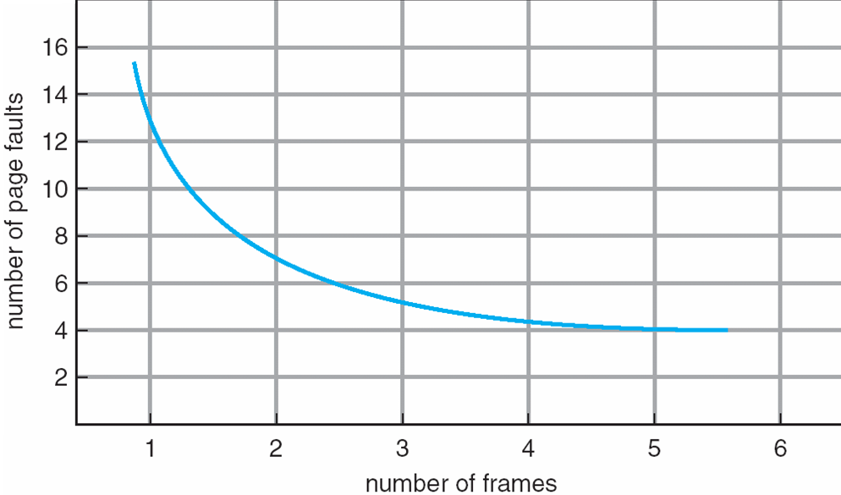
Graph of Page Faults Versus The Number of Frames
Notes:
93

Slide 30
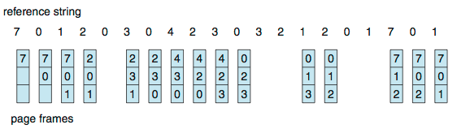
First-In-First-Out (FIFO) Algorithm
Reference string: 7,0,1,2,0,3,0,4,2,3,0,3,0,3,2,1,2,0,1,7,0,1
3 frames (3 pages can be in memory at a time per process)
How to track ages of pages?
Use a FIFO queue
Can vary by reference string: consider 1,2,3,4,1,2,5,1,2,3,4,5
Adding more frames can cause more page faults!
Belady’s Anomaly
15 page faults
Notes:
93

Slide 31
FIFO Illustrating Belady’s Anomaly
Notes:
93

Slide 32
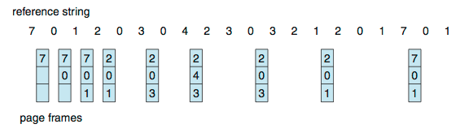
Optimal Algorithm
Replace that page, which will not be used for longest period of time
How do you know this? (requires future knowledge of the reference string)
Use of this page-replacement algorithm guarantees the lowest possible page fault rate for a fixed number of frames.
Notes:
93

Slide 33
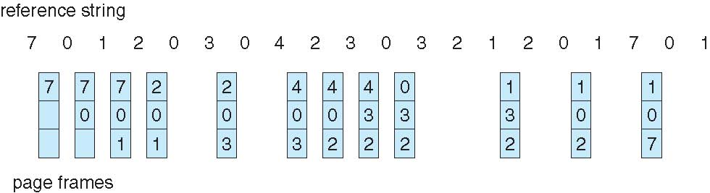
Least Recently Used (LRU) Algorithm
Use past knowledge rather than future
Replace page that has not been used in the most amount of time
Associate time of last use with each page
12 faults – better than FIFO but worse than OPT
Generally good algorithm and frequently used
But how to implement?
Notes:
93

Slide 34
LRU Algorithm (Cont.)
LRU and OPT are cases of stack algorithms that don’t have Belady’s Anomaly
Counter implementation
Every page entry has a counter; every time page is referenced through this entry, copy the clock into the counter
When a page needs to be changed, look at the counters to find smallest value
Search through table needed
Notes:
93

Slide 35
LRU Algorithm: Stack implementation
A stack of page numbers:
Whenever a page is referenced, it is removed from the stack and put on the top.
In this way, the most recently used page is always at the top of the stack and the least recently used page is always at the bottom
Because entries must be removed from the middle of the stack, it is best to implement this approach by using a doubly linked list with a head pointer and a tail pointer.

Slide 36
Use of A Stack to Record Most Recent Page References
Notes:
93

Slide 37
LRU Approximation Algorithms
LRU needs special hardware and still slow
Reference bit
Reference bits are associated with each entry in the page table, initially all cleared to 0
When page is referenced bit set to 1 (read/write a byte) as a user process executes
the bit associated with each page referenced is set (to 1) by the hardware.
After some time, we can determine which pages have been used and which have not been used by examining the reference bits
Replace any with reference bit = 0 (if one exists)
We do not know the order, however
Notes:
93

Slide 38
Additional-Reference-Bits Algorithm
Record reference bits at regular intervals
At regular intervals (say, every 100 milliseconds), a timer interrupt transfers control to the operating system.
8-bit shift registers containing the history of page use for the last eight time periods shifted by the operating system to the right by 1-bit
A page with a history register value of 11000100 has been used more recently than one with a value of 01110111.
If we interpret these 8-bit bytes as unsigned integers, the page with the lowest number is the LRU page, and it can be replaced.

Slide 39
LRU Approximation Algorithms
Second-chance algorithm
Generally FIFO, plus hardware-provided reference bit
Clock the replacement
If page to be replaced has
Reference bit = 0 -> replace it
Reference bit = 1 then:
set reference bit 0, leave page in memory and move on to select the next FIFO page.
When a page gets a second chance, its reference bit is cleared, and its arrival time is reset to the current time.
Thus, a page that is given a second chance will not be replaced until all other pages have been replaced / given second chance
if a page is used often enough to keep its reference bit set, it will never be replaced.

Slide 40
Second-Chance (Clock) Page-Replacement Algorithm
Notes:
93

Slide 41
Enhanced Second-Chance Algorithm
Improve algorithm by using reference bit and modify bit as ordered pair (reference, modify)
(0, 0) neither recently used not modified – best page to replace
(0, 1) not recently used but modified – not quite as good, must write out before replacement
(1, 0) recently used but clean – probably will be used again soon
(1, 1) recently used and modified – probably will be used again soon and need to write out before replacement
When page replacement called for, use the clock scheme but use the four classes replace page in lowest non-empty class
Might need to search circular queue several times
Give preference to those pages that have been modified in order to reduce the number of I/Os required
Notes:
93

Slide 42
Counting Algorithms
Keep a counter of the number of references that have been made to each page
Not common
Lease Frequently Used (LFU) Algorithm: replaces page with smallest count
Most Frequently Used (MFU) Algorithm: based on the argument that the page with the smallest count was probably just brought in and has yet to be used
Notes:
93

Slide 43
Page-Buffering Algorithms
When a page fault occurs, a victim frame is chosen as before
Keep a pool of free frames, always
Then frame is available when needed
Desired page is read into a free frame from the pool before the victim is written out
Select victim to evict and add to free pool
When convenient, evict victim
Possibly, keep list of modified pages
When backing store otherwise idle, write pages there and set to non-dirty i.e. modify bit is reset

Slide 44
Page-Buffering Algorithms
Keep a pool of free frames but to remember which page was in each frame.
Since the frame contents are not modified when a frame is written to the disk, the old page can be reused directly from the free-frame pool if it is needed before that frame is reused.
No I/O is needed in this case.
When a page fault occurs, we first check whether the desired page is in the free-frame pool.
If it is not, we must select a free frame and read into it.

Slide 45
Applications and Page Replacement
All of these algorithms have OS guessing about future page access
Some applications have better knowledge – i.e. databases
Memory intensive applications can cause double buffering
OS keeps copy of page in memory as I/O buffer
Application keeps page in memory for its own work
Operating system can given direct access to the disk, getting out of the way of the applications
Raw disk mode

Slide 46
Allocation of Frames
Each process needs minimum number of frames
As the number of frames allocated to each process decreases, the page-fault rate increases, slowing process execution.
In addition when a page fault occurs before an executing instruction is complete, the instruction must be restarted.
Consequently, we must have enough frames to hold all the different pages that any single instruction can reference
Notes:
93

Slide 47
Allocation of Frames
Consider a machine in which all memory-reference instructions may reference only one memory address.
In this case, we need at least one frame for the instruction and one frame for the memory reference.
Two frames per instruction of the process
The minimum number of frames is defined by the computer architecture
Maximum is total frames in the system
Two major allocation schemes
fixed allocation
priority allocation

Slide 48
Fixed Allocation
Equal allocation – For example, if there are 100 frames (after allocating frames for the OS) and 5 processes, give each process 20 frames
Keep some as free frame buffer pool
Proportional allocation – Allocate memory to the process according to the size of process
Dynamic as degree of multiprogramming, process sizes change
Notes:
93

Slide 49
Priority Allocation
Use a proportional allocation scheme using priorities rather than size
If process P_{i} generates a page fault,
select for replacement one of its frames
select for replacement a frame from a process with lower priority number
Notes:
93

Slide 50
Global vs. Local Allocation
Global replacement – process selects a replacement frame from the set of all frames; one process can take a frame from another
But then process execution time can vary greatly
But greater throughput so more common
With priority
Local replacement – each process selects from only its own set of allocated frames
More consistent per-process performance
But possibly underutilized memory
Notes:
93

Slide 51
Non-Uniform Memory Access
Systems in which memory access times vary significantly are known collectively as non-uniform memory access (NUMA) systems, and are slower than systems in which memory and CPUs are located on the same motherboard.
Many systems are NUMA – speed of access to memory varies
System boards containing CPUs and memory, interconnected over a system bus
Managing which page frames are stored at which locations can significantly affect performance in NUMA systems.

Slide 52
Non-Uniform Memory Access
If we treat memory as uniform in such a system, CPUs may wait significantly longer for memory access than if we modify memory allocation algorithms to take NUMA into account.
Similar changes must be made to the scheduling system.

Slide 53
Non-Uniform Memory Access
So allocate memory frames “as close as possible” to the CPU on which the process is running.
Modify scheduler to schedule the thread on the same system board when possible
Algorithmic changes consist of having the scheduler track the last CPU on which each process ran.
If the scheduler tries to schedule each process onto its previous CPU, and the memory-management system tries to allocate frames for the process close to the CPU on which it is being scheduled, then improved cache hits and decreased memory access times will result.

Slide 54
Non-Uniform Memory Access
Solved by Solaris by creating lgroups
Structure to track CPU / Memory low latency groups
Each lgroup gathers together close CPUs and memory.
There is a hierarchy of lgroups based on the amount of latency between the groups.
Solaris tries to schedule all threads of a process and allocate all memory of a process within an lgroup.
If that is not possible, it picks nearby lgroups for the rest of the resources needed.

Slide 55
Thrashing
If a process does not have “enough” pages, the page-fault rate is very high
However, if all pages of the process are in active use, it must replace a page (that will be needed again right away)
Consequently, the process faults immediately, and again, and again, replacing pages that it must bring back in immediately
Thrashing ≡ An activity where a process is busy swapping pages in and out (high paging activity)
Notes:
93

Slide 56
Thrashing
Process does a page fault to get page
OS to replace existing frame
But quickly need replaced frame back (because the pages are active)

Slide 57
Thrashing
Process starts faulting and taking frames away from other processes.
These processes need those pages, however, and so they also fault, taking frames from other processes.
These faulting processes must use the paging device to swap pages in and out.
As they queue up for the paging device, the ready queue empties
As processes wait for the paging device, CPU utilization decreases.
This leads to: Low CPU utilization
Operating system thinking that it needs to increase the degree of multiprogramming
Another process added to the system

Slide 58
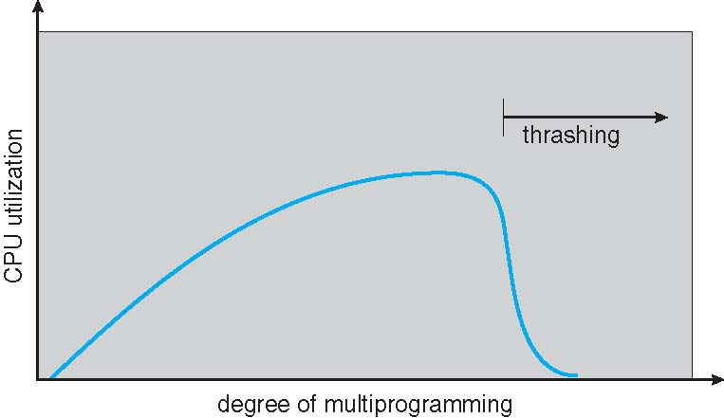
Thrashing (Cont.)
Notes:
93

Slide 59
Thrashing
Due to thrashing system throughput plunges
Page fault rate increases tremendously.
As a result, the effective memory-access time increases.
No work gets done, because the processes are spending all their time paging.
To increase CPU utilization and stop thrashing, we must decrease the degree of multiprogramming

Slide 60
Demand Paging and Thrashing
We can limit the effects of thrashing by using a local replacement algorithm
Here, if one process starts thrashing, it cannot steal frames from another process and cause the latter to thrash as well.
Nonetheless, average service time for a page fault will increase because of the longer average queue for the paging device.
Thus, the effective access time will increase even for a process that is not thrashing.
To prevent thrashing, we must provide a process with as many frames as it needs.

Slide 61
Demand Paging and Thrashing
A locality is a set of pages that are actively used together
A program is generally composed of several different localities, which may overlap.
Locality model
Process migrates from one locality to another
Localities may overlap
Why does thrashing occur?
Σ size of locality > total memory size
Notes:
93

Slide 62
Locality
For example, when a function is called, it defines a new locality.
In this locality, memory references are made to the instructions of the function call, its local variables, and a subset of the global variables.
When we exit the function, the process leaves this locality, since the local variables and instructions of the function are no longer in active use.
We may return to this locality later.

Slide 63
Locality Model
States that, as a process executes, it moves from locality to locality.
Localities are defined by the program structure and its data structures.
The locality model states that all programs will exhibit this basic memory reference structure
Suppose we allocate enough frames to a process to accommodate its current locality.
It will fault for the pages in its locality until all these pages are in memory; then, it will not fault again until it changes localities.

Slide 64
Locality Model
To prevent thrashing, we must provide a process with as many frames as it needs.
The working-set strategy starts by looking at how many frames a process is actually using
If we do not allocate enough frames to accommodate the size of the current locality, the process will thrash, since it cannot keep in memory all the pages that it is actively using

Slide 65
Working-Set Model
Δ ≡ working-set window
≡ a fixed number of page references Example: 10,000 instructions
The set of pages in the most recent Δ page references is the working set
If a page is in active use, it will be in the working set.
If it is no longer being used, it will drop from the working set Δ time units after its last reference.
Thus, the working set is an approximation of the program’s locality.
Each process is actively using the pages in its working set

Slide 66
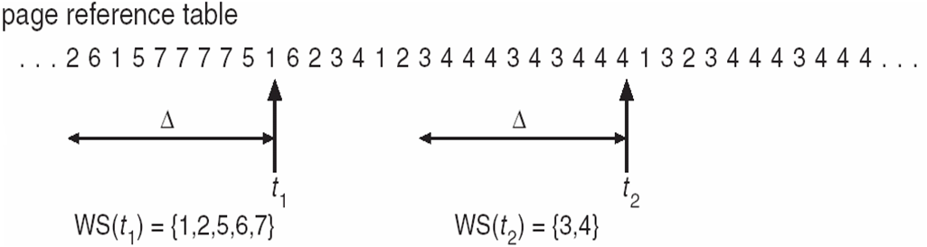
Working-Set Model
WSS_{i} (working set of Process P_{i}) = total number of pages referenced in the most recent Δ (varies in time)
The accuracy of the working set depends on the selection of Δ.
if Δ too small will not encompass entire locality
if Δ too large will encompass several localities
if Δ = ∞ ⇒ will encompass entire program
Total demand frames, D = Σ WSS_{i} (process i needs WSSi frames)
If D > m ⇒ Thrashing
Policy if D > m, then suspend or swap out one of the processes
Notes:
93

Slide 67
Working-Set Model
OS monitors and allocates working set of each process enough frames according to its working-set size.
If there are enough extra frames, another process can be initiated.
If the sum of the working-set sizes increases, exceeding the total number of available frames, the operating system selects a process to suspend.
The process’s pages are written out (swapped), and its frames are reallocated to other processes.
The suspended process can be restarted later.

Slide 68
Keeping Track of the Working Set
Approximate the WS model with a fixed interval timer + a reference bit
Example: Δ = 10,000
Timer interrupts after every 5000 time units
Keep in memory 2 bits for each page
Whenever a timer interrupts, copy and set the values of all reference bits to 0
If one of the bits in memory = 1 ⇒ page in working set
Notes:
93

Slide 69
How to implement working set model
When fault occurs can evict page not in working set
Need to pick k
Could keep track of pages in memory at every memory reference.
Each k references results in a working set.
Shift register implementation. Insert page number at each reference.
Expensive
Tanenbaum, Modern Operating Systems 3 e, (c) 2008 Prentice-Hall, Inc. All rights reserved. 0-13-6006639

Slide 70
Page-Fault Frequency
When page fault rate is too high, we know that the process needs more frames.
Conversely, if the page-fault rate is too low, then the process may have too many frames.
Establish upper and lower bounds on the desired page-fault rate

Slide 71
Page-Fault Frequency
More direct approach than WSS
Establish “acceptable” page-fault frequency (PFF) rate and use local replacement policy
If actual rate too low, we remove a frame from the process
If actual rate too high, process gains frame
Notes:
93

Slide 72
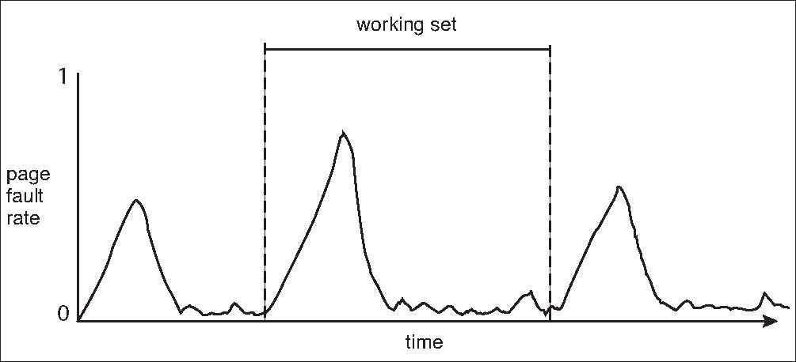
Working Sets and Page Fault Rates
Direct relationship between working set of a process and its page-fault rate
Working set changes over time
Peaks and valleys over time

Slide 73
Use virtual time instead of number of references (k)
Keep track of k last pages referenced during a period t of execution (CPU) time
Virtual time for a process is the amount of CPU time used since it started
Measure of how much work a process has done
Tanenbaum, Modern Operating Systems 3 e, (c) 2008 Prentice-Hall, Inc. All rights reserved. 0-13-6006639

Slide 74
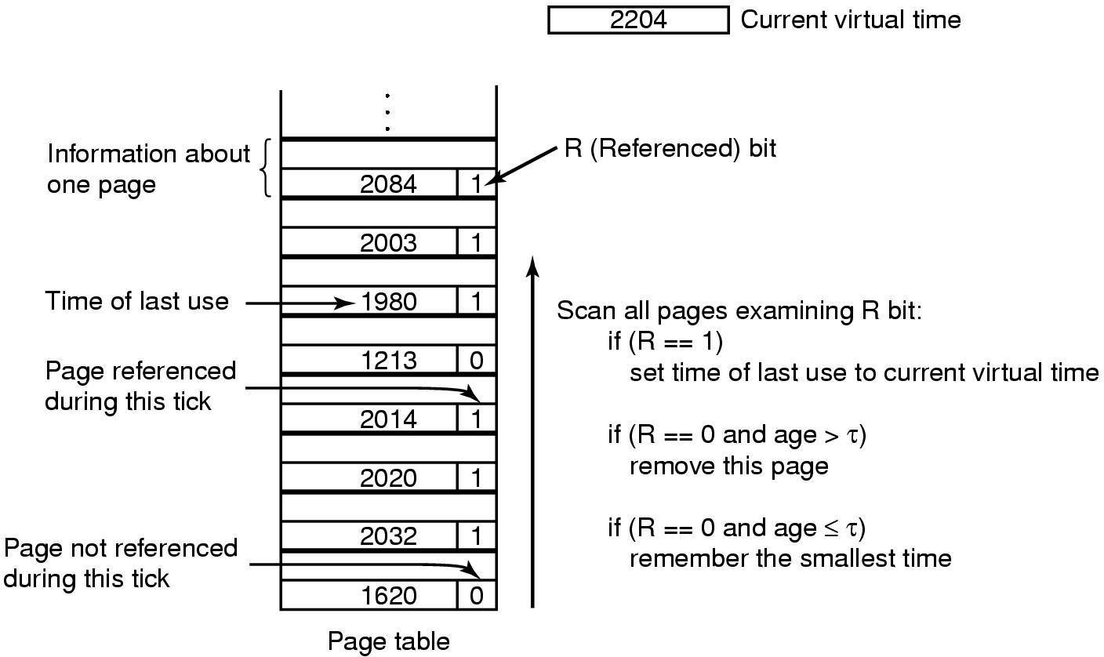
Working Set Page Replacement
(Check each clock tick)
Check each clock tick
Get rid of page with smallest time if all of the pages have R==0
Tanenbaum, Modern Operating Systems 3 e, (c) 2008 Prentice-Hall, Inc. All rights reserved. 0-13-6006639

Slide 75
Weakness with WS algorithm
Need to scan entire page table at each page fault to find a victim
Use clock idea with working set algorithm
Tanenbaum, Modern Operating Systems 3 e, (c) 2008 Prentice-Hall, Inc. All rights reserved. 0-13-6006639

Slide 76
Memory-Mapped Files
Each file access requires a system call and disk access.
We can also use virtual memory techniques to treat file I/O as routine memory accesses.
Memory-mapped file I/O allows file I/O to be treated as routine memory access by mapping a disk block to a page in memory
Process issues system call to map a file onto a part of its virtual address space.
A file is initially read using demand paging
A page-sized portion of the file is read from the file system into a physical page
Subsequent reads/writes to/from the file are treated as ordinary memory accesses
Notes:
93

Slide 77
Memory-Mapped Files
Simplifies and speeds file access by driving file I/O through memory rather than read() and write() system calls
Also allows several processes to map the same file allowing the pages in memory to be shared
Writes by any of the processes modify the data in virtual memory and can be seen by all others that map the same section of the file.

Slide 78
Memory Mapped Files
Notes:
93

Slide 79
Memory-Mapped Files
But when does written data make it to the disk?
The writes to the file mapped in memory are not necessarily immediate (synchronous) writes to the file on disk.
Some systems may choose to update the physical file when the operating system periodically checks whether the page in memory has been modified e.g. when the pager scans for dirty pages
When the file is closed, all the memory-mapped data are written back to disk and removed from the virtual memory of the process

Slide 80
Memory-Mapped Files
Some OSes uses memory mapped files for standard I/O
Process can explicitly request memory mapping a file via mmap() system call
Now file mapped into process address space

Slide 81
Memory-Mapped File Technique for all I/O
Solaris:
For standard I/O (open(), read(), write(), close()), file is memory mapped using mmap() system call
But map file into kernel address space
Process still does read() and write()
Copies data to and from kernel space and user space
Uses efficient memory management subsystem
Avoids needing separate subsystem
Memory mapped system calls also support copy-on-write functionality for read/write non-shared pages (implement mutual exclusion)

Slide 82
Memory-Mapped Files
Memory mapped files can be used for shared memory (although again via separate system calls)
Processes can communicate using shared memory by having the communicating processes memory-map the same file into their virtual address spaces.
The memory-mapped file serves as the region of shared memory between the communicating processes

Slide 83
Shared Memory via Memory-Mapped I/O
Notes:
93

Slide 84
Problem
Consider a demand-paging system with the following time-measured utilizations:
CPU utilization 20%
Paging disk 97.7%
Other I/O devices 5%
For each of the following, say whether it will (or is likely to) improve CPU utilization. Explain your answers.
Install a faster CPU.
Install a bigger paging disk.
Increase the degree of multiprogramming.
Decrease the degree of multiprogramming.
Install more main memory.
Install a faster hard disk or multiple controllers with multiple hard disks.
Add prepaging to the page fetch algorithms.
Increase the page size.

Slide 85
Problem
Is it possible for a process to have two working sets, one representing data and another representing code? Explain.

Slide 86
Copy-on-Write (CoW)
Multiple processes may be allowed to map the same file concurrently, to allow sharing of data.
Writes by any of the processes modify the data in virtual memory and can be seen by all others that map the same section of the file.
When two processes are accessing the same set of program values (for example code), then it is useful to map the corresponding pages into the virtual address spaces of the two programs in a write-protected manner.
Mutual Exclusion principle will apply
When a write does indeed take place, then a copy must be made to allow the two programs to individually access the different copies without interfering with each other.

Slide 87
Allocating Kernel Memory
When a process running in user mode requests additional memory, pages are allocated from the list of free page frames maintained by the kernel.
Page replacement algorithm is run
Pages are scattered throughout
Kernel Memory treated differently from user memory
Often allocated from a free-memory pool
Kernel requests memory for data structures of varying sizes (may be smaller than a page)
Some kernel memory needs to be contiguous
i.e. for device I/O: access memory directly
Notes:
93

Slide 88
Buddy System
Allocates memory from fixed-size segment consisting of physically-contiguous pages
Memory allocated using power-of-2 allocator
Satisfies requests in units sized as power of 2
Request rounded up to next highest power of 2
When smaller allocation needed than is available, current chunk split into two buddies of next-lower power of 2
Continue until appropriate sized chunk available
For example, assume 256KB chunk available, kernel requests 21KB
Split into A_{L} _{and} A_{R} of 128KB each
One further divided into B_{L} and B_{R} of 64KB
One further into C_{L} and C_{R} of 32KB each – one used to satisfy request
Advantage – quickly coalesce unused chunks into larger chunk
Disadvantage - fragmentation
Notes:
93

Slide 89
Buddy System Allocator
Notes:
93

Slide 90
Slab Allocator
Alternate strategy
Slab is one or more physically contiguous pages
Cache consists of one or more slabs
A cache each for each unique kernel data structure
Each cache filled with objects – instantiations of the data structure
Process descriptors, file objects and semaphores
When cache created, filled with objects marked as free
When structures stored, objects marked as used
If slab is full of used objects, next object allocated from empty slab
If no empty slabs, new slab allocated
Benefits include no fragmentation, fast memory request satisfaction
Notes:
93

Slide 91
Slab Allocation
Notes:
<number>

Slide 92
Slab Allocation
When a cache is created, a number of objects—which are initially marked as free—are allocated to the cache.
The number of objects in the cache depends on the size of the associated slab.
For example, a 12-KB slab (made up of three contiguous 4-KB pages) could store six 2-KB objects.
Initially, all objects in the cache are marked as free.
When a new object for a kernel data structure is needed, the allocator can assign any free object from the cache to satisfy the request.
The object assigned from the cache is marked as used.

Slide 93
Slab Allocator in Linux
For example process descriptor is of type struct task_struct
Approx 1.7KB of memory
New task -> allocate new struct from cache
Will use existing free struct task_struct
Slab can be in three possible states
Full – all used
Empty – all free
Partial – mix of free and used
Upon request, slab allocator
Uses free struct in partial slab
If none, takes one from empty slab
If no empty slab, create new empty
Notes:
<number>

